Slide 1
Design and Implementation of a Parallel Graphics Rendering Engine
Kyuhyeon Nam , Ke Wang
EE/CSCI 451: Project Presentation
University of Southern California

Slide 2
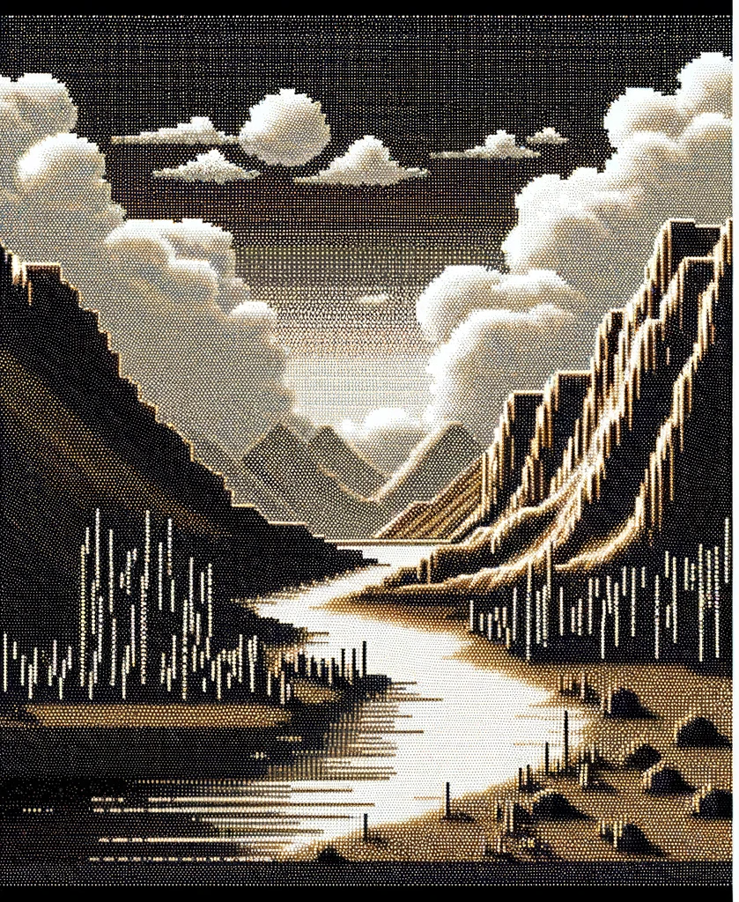

Introduction
<Early graphics>
<Modern graphics>
Notes:
Over the past several decades, the field of computer graphics has continuously evolved and advanced, resulting in increasingly realistic graphic images.
These advancements can be attributed to the ever-improving computing power.
We aim to explore the most efficient and fast means of achieving exceptional graphical quality through the utilization of parallel 3D rendering technology.

Slide 3
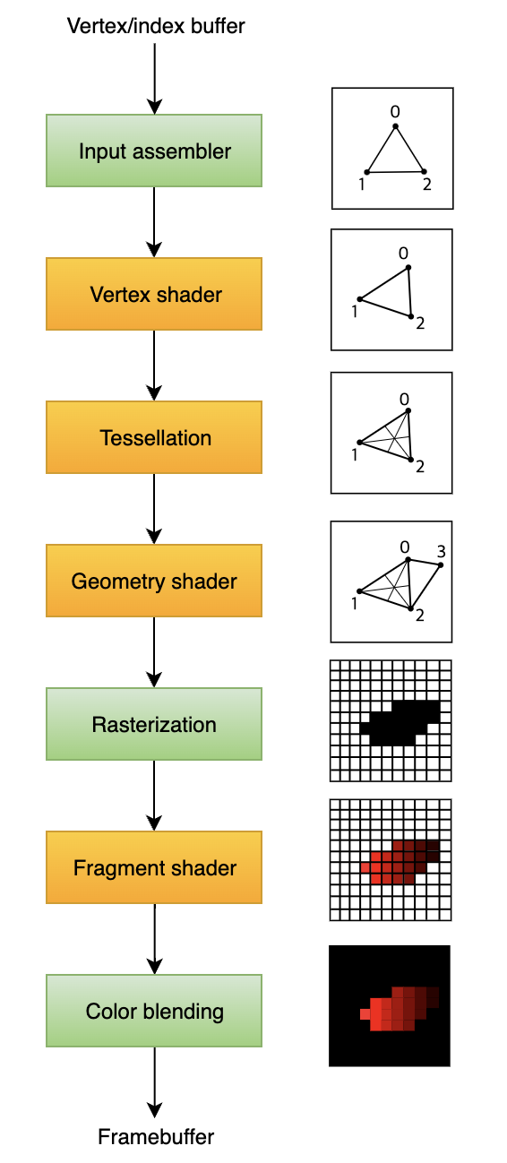
Context
Rendering pipeline
: Compute bound
: Memory bound
Notes:
Vertex/Index Buffer: Stores the coordinates and other data for each point of a 3D shape.
Input Assembler: Gathers and organizes vertex data into a format that can be used by the next stages.
Vertex Shader: Manipulates vertex data (like position, texture coordinates) for 3D transformation and lighting.
Tessellation: Subdivides shapes to add more geometric detail to the 3D model.
Geometry Shader: Further shapes the geometry by adding or modifying vertices after tessellation.
Rasterization: Converts the 3D shape into a 2D pixel grid, determining which pixels the shape covers.
Fragment Shader: Colors the pixels, adding textures and lighting effects to each one.
Color Blending: Mixes the new pixel colors with the existing ones in the frame buffer to produce the final colors.
Framebuffer: Holds the completed image ready to be sent to the display.
Compute-Bound Stages:
These stages are typically limited by the processing power of the CPU/GPU due to their intensive computational requirements.
Vertex Shader: Involves complex mathematical operations for transforming vertices, which are compute-intensive.
Tessellation Control Shader: Decides the level of tessellation, often requiring significant computation.
Tessellation Evaluation Shader: Computes the positions of tessellated vertices, a compute-intensive task.
Geometry Shader: Can involve complex calculations to generate new geometry or alter existing one.
Fragment Shader: Involves computation of pixel colors, including executing lighting and texturing operations which can be very compute-intensive depending on the shader's complexity.
Memory-Bound Stages:
These stages are typically limited by the memory throughput (bandwidth) and latency because they require access to large amounts of data.
Vertex/Index Buffer: The data must be fetched from memory, which can be memory-intensive for large models.
Rasterization: While not typically memory-bound, high-resolution outputs can require substantial memory bandwidth.
Texturing: Requires fetching texture data from memory, which can be bandwidth-intensive, especially for high-resolution textures or complex texture mapping techniques.
Color Blending: Involves reading from and writing to the framebuffer, which can be memory-intensive, especially at higher resolutions and with complex blending operations.
The Framebuffer operations are also memory-bound since they involve writing the final pixel data to memory for display output. The balance between compute-bound and memory-bound can shift based on the application's specific rendering tasks, the complexity of the shaders, the size and complexity of the 3D models, and the resolution at which the scene is being rendered.

Slide 4
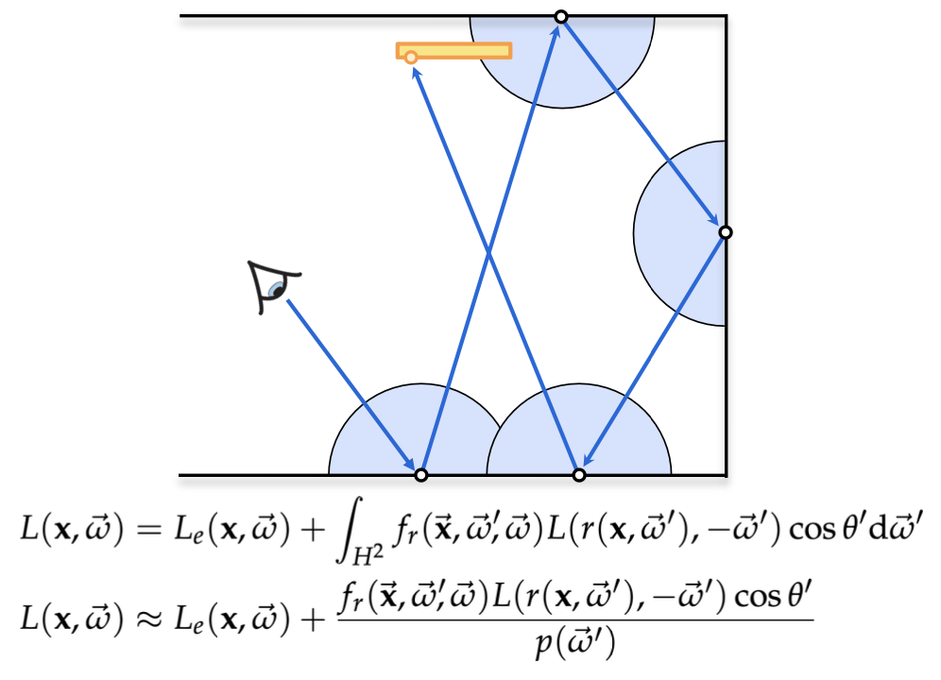
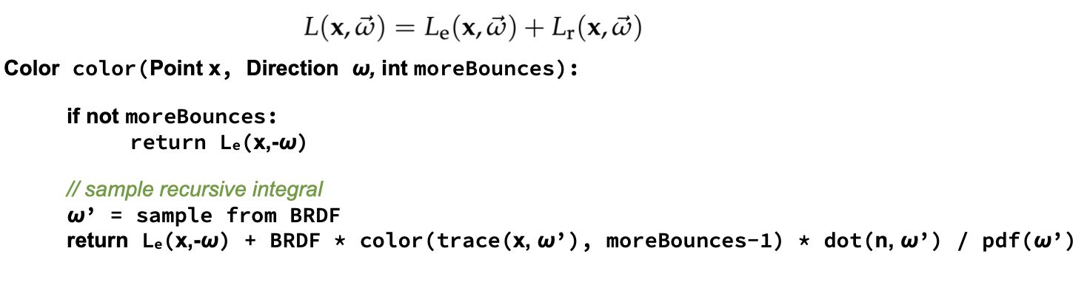
Context
“Path Tracing” for realistic
<Rendering Equation>
<Path Tracing Algorithm>
Notes:
To obtain more realistic images, we should consider using path tracing.
Path tracing is a more modern method of modeling dynamic lighting in a scene. Developed in the mid 1980s, it takes a different approach by sending out hundreds or even thousands of rays at a time from a light source, and then tracking them as they bounce randomly around a scene. This is a lot more complicated on the surface, but the end result is an easier render, since instead of tracking every single ray from pixel to source, it only tracks a sample of those rays based on the most likely path the light would take.

Slide 5
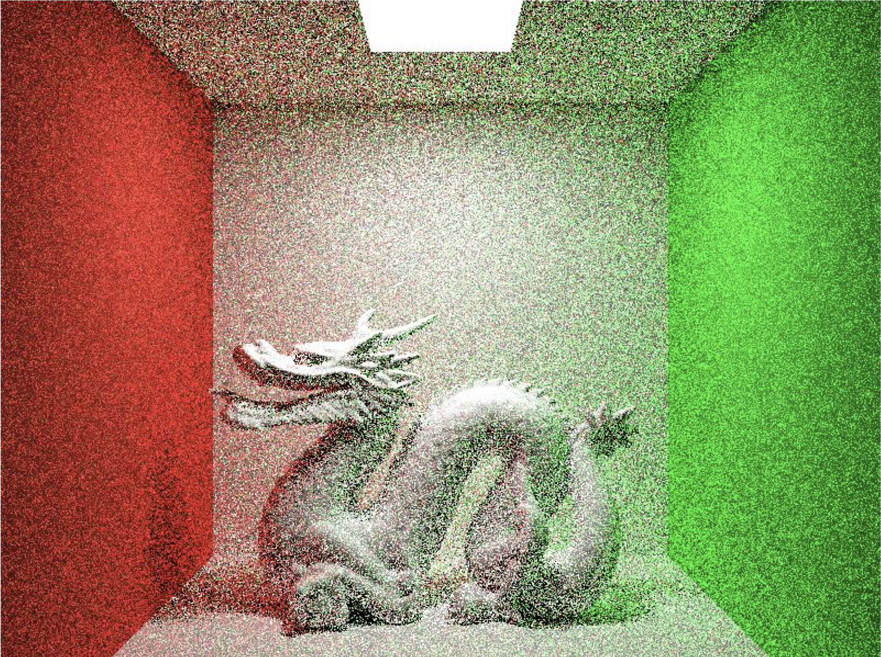
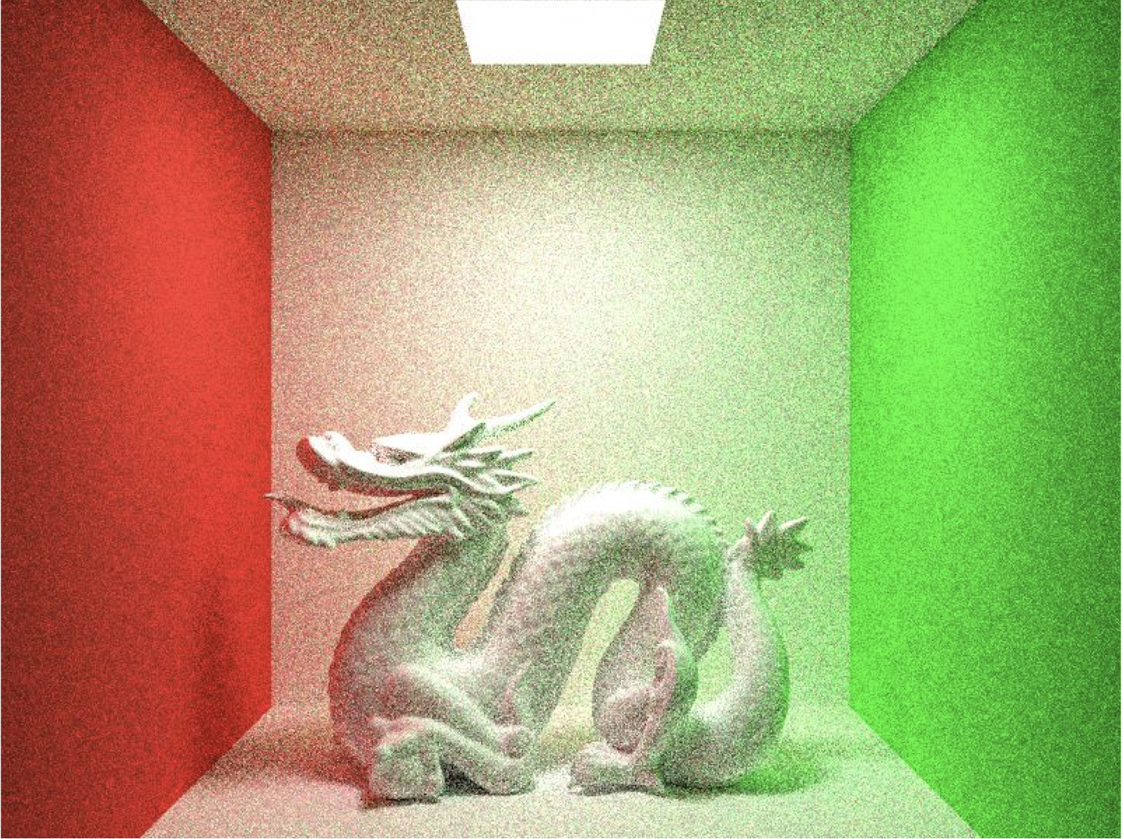
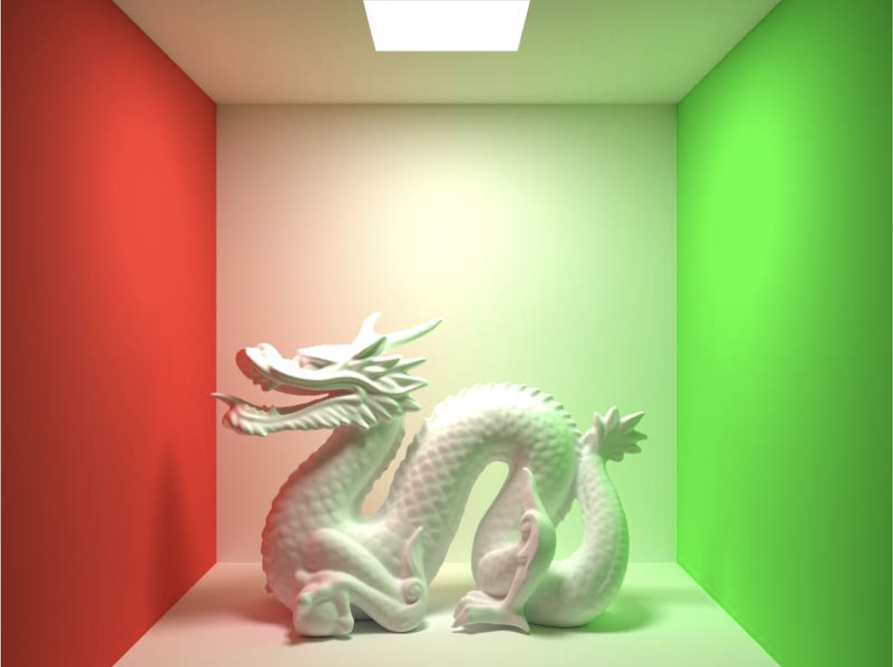
Context
“Path Tracing” for realistic (cont.)
<1 Path / Pixel>
<10 Path / Pixel>
<10000 Path / Pixel>
Notes:
The visualization showcases how the quality of the final render changes with the number of paths per pixel in the path tracing algorithm.
Path tracing is a rendering technique that simulates how light interacts with surfaces.
It is an enhanced version of ray tracing that calculates multiple possible paths that light can take to reach the camera.

Slide 6
Hypothesis
Scalabiblity--Color of each pixel can be calculated independently(The interactions between the beams are not considered)
"Parallel Computing as a Solution”
Each thread is responsible for multiple pixels
Using GPU(CUDA) more efficiently reduces rendering time-more resources and high speed computation
Notes:
Our hypothesis is very simple.

Slide 7
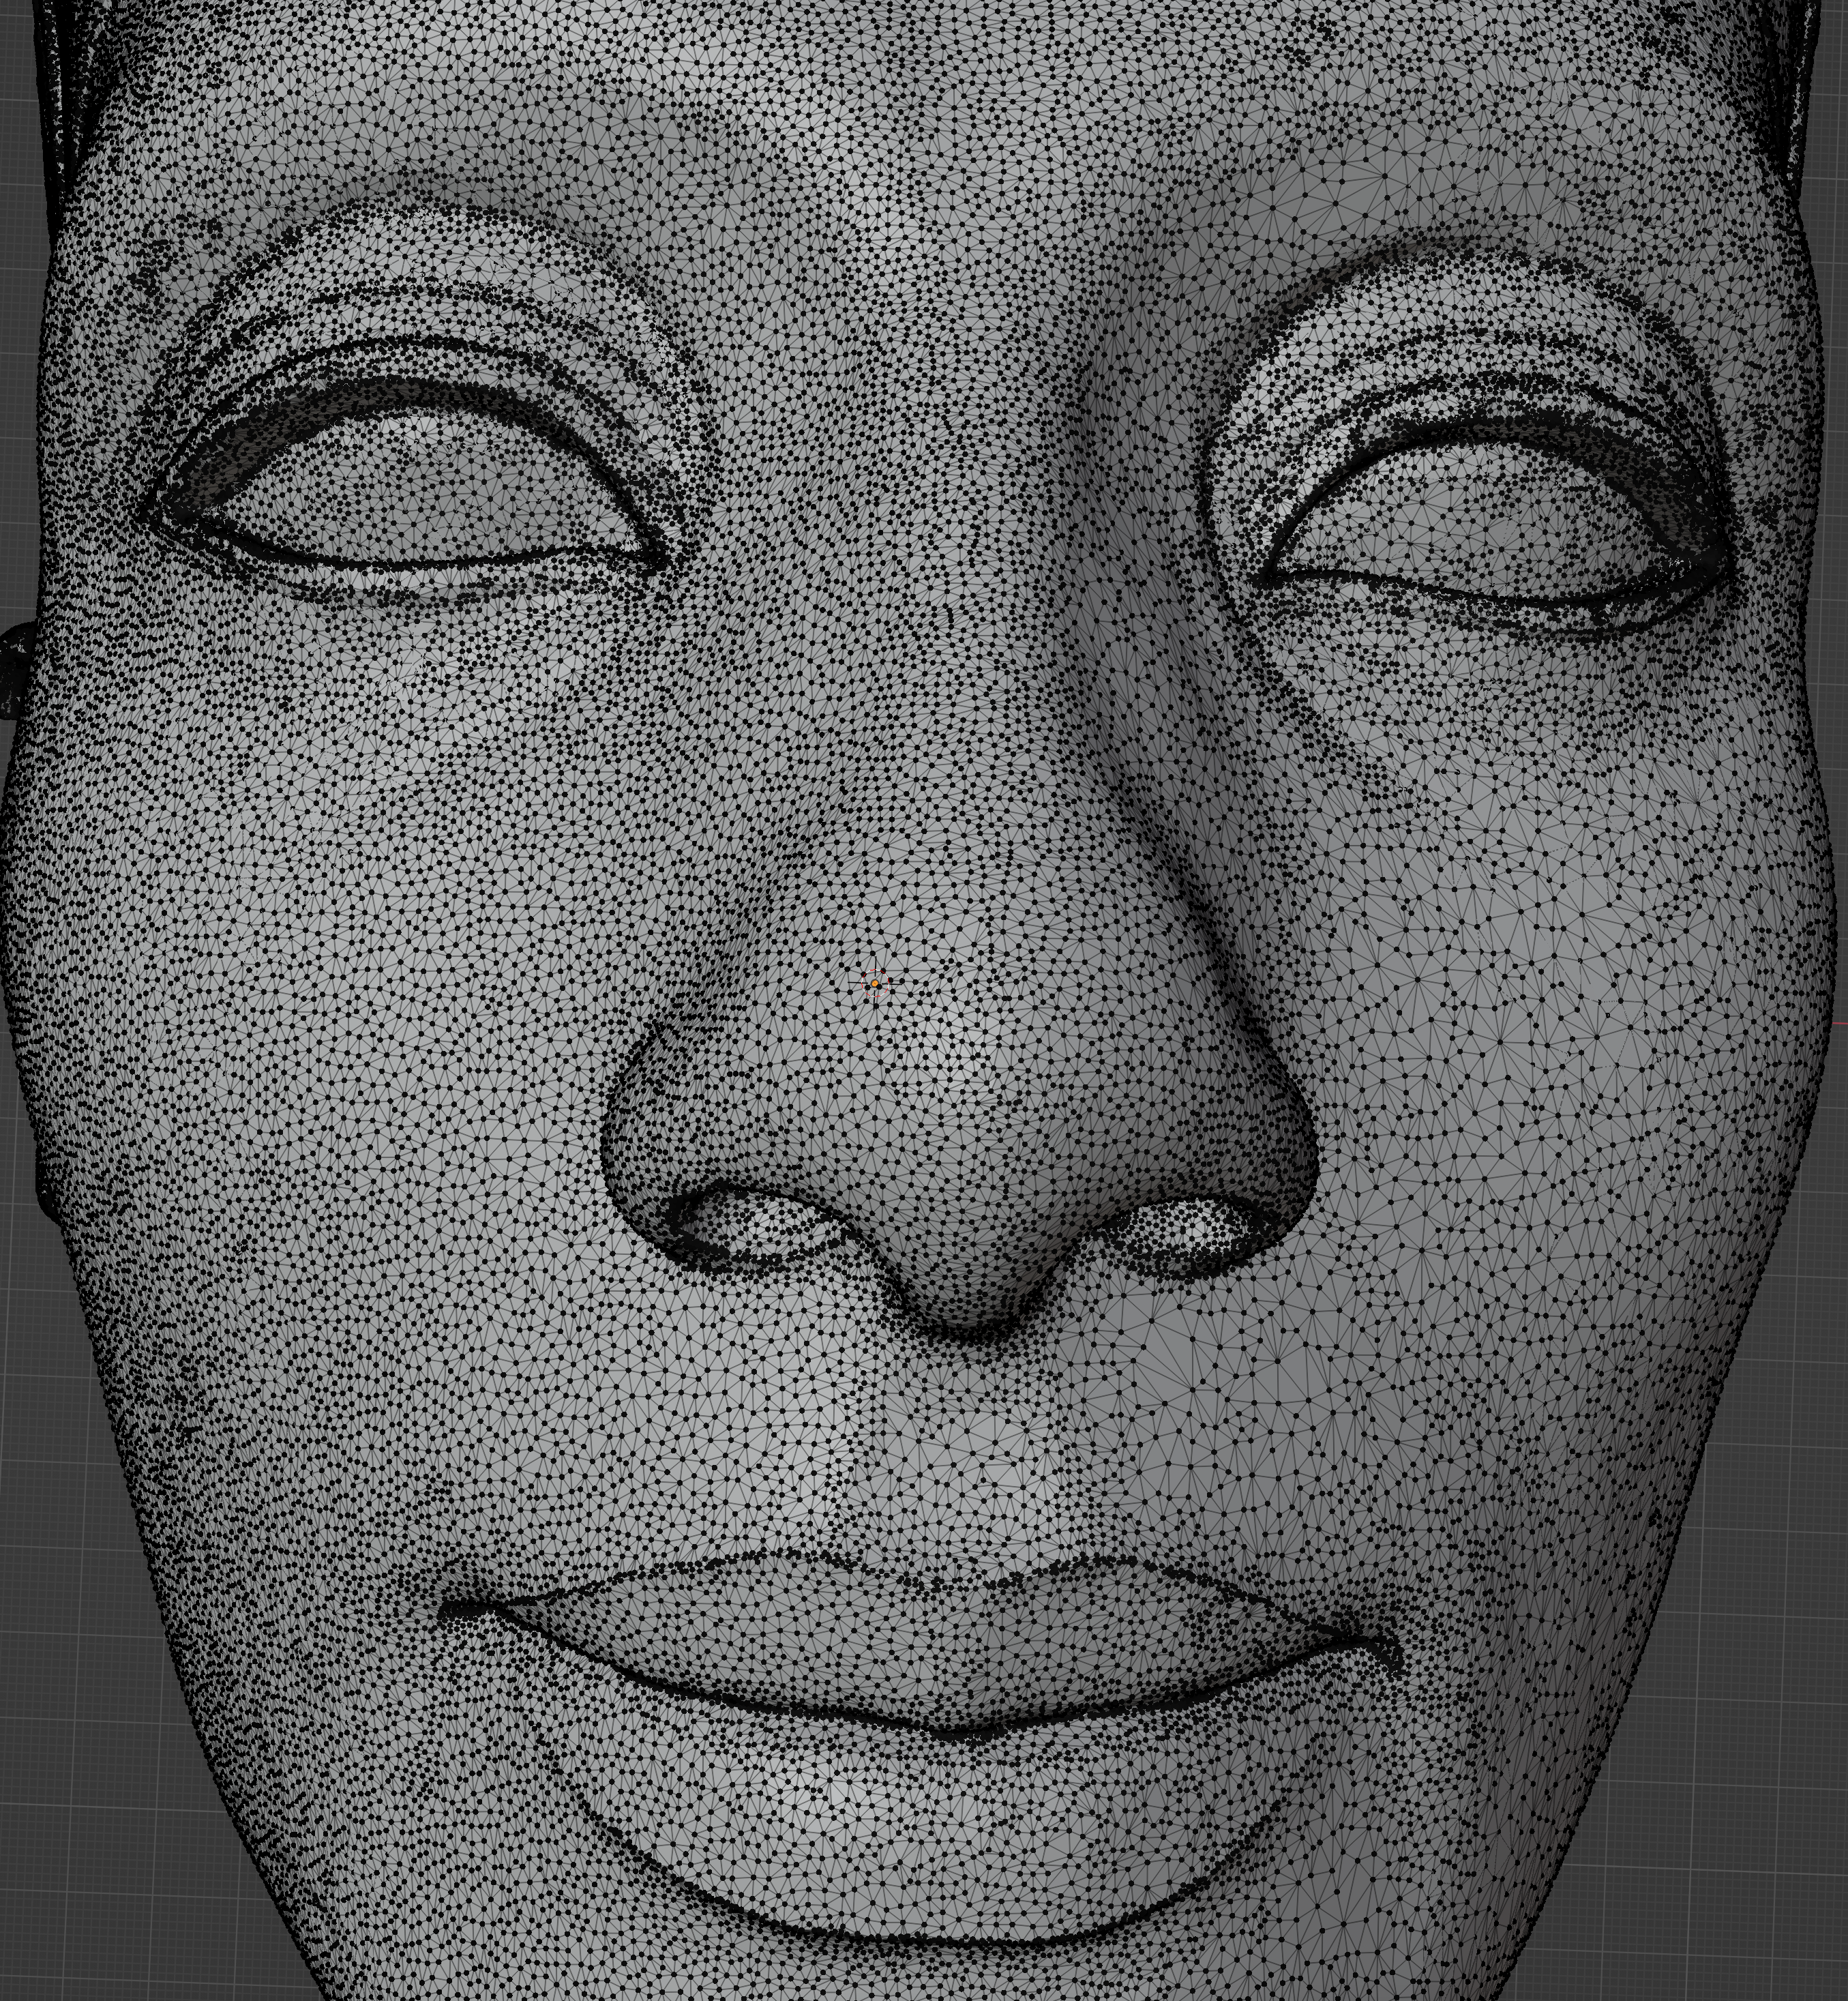

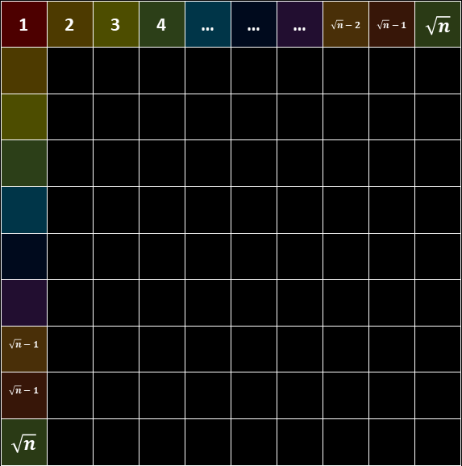
Key idea
$$\sqrt{N}$$
1 | 2 | 3 | 4 | … | … | … | $$\sqrt{n}−2$$ | $$\sqrt{n}−1$$ | $$\sqrt{n}$$
$$\sqrt{n}−1$$
$$\sqrt{n}−1$$
$$\sqrt{n}$$
Changing the algorithm is not our Goal.
N threads responsible for vertices
Assembling Triangle (Vertice → triangle)
Triangle: Move, Scale, Rotate
$$\sqrt{N}$$
Notes:
Our objective is not to change the path-tracing algorithm, even though it could significantly reduce the rendering time.
to parallelize the computation involved in assembling vertices into polygons (triangles in this case)
and performing transformations on those triangles such as moving (translation), scaling, and rotating them.
These operations can be computationally intensive when dealing with a large number of vertices and triangles, making them good candidates for parallelization.

Slide 8

Key idea
$$\sqrt{N}$$
Changing the algorithm is not our Goal.
N threads responsible for each block
BlockSize = No. of Pixel / No. of Threads
$$\sqrt{N}$$

Slide 9
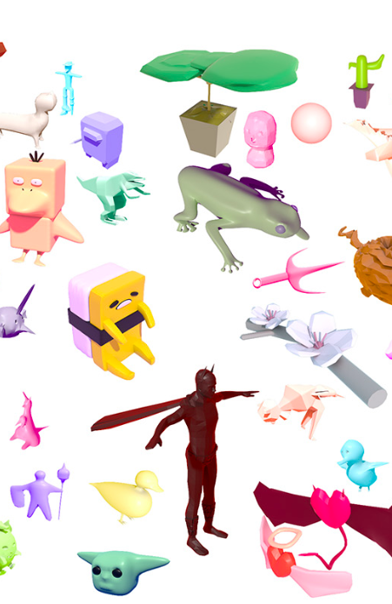
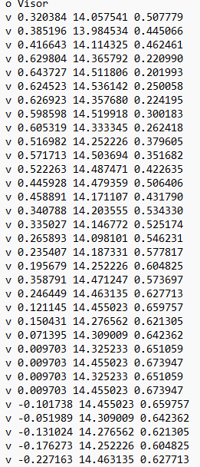
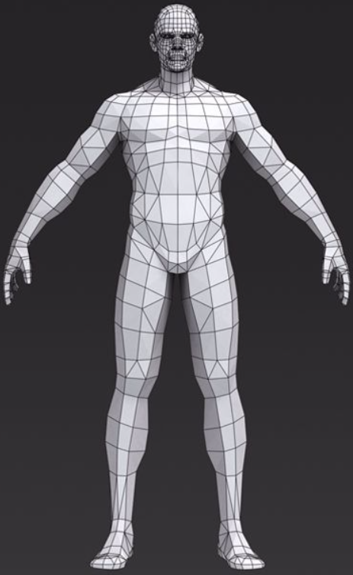
Challenge: Loading the scene
Vertices
Meshes
Triangles
Materials
Textures
Positions
Rotations
...

Slide 10
Challenge: Algorithm
Where should I place the camera?
How to calculate ray direction?
How to know if the ray is blocked?
How to simulate the light path in a physical-based way?
Radiance?
How to calculation the integral?
How many times should a ray be reflected?
How to speed up the whole process?
...

Slide 11
Challenge: Parallelization
Can we parallize the loading process?
Can we parallize the algorithm for each pixel? (Multiple sample points)
How to balance the calcutaion time and the image quality?
Threads number
How to write codes of CUDA programs within cpp project?
Where and when to malloc and memcpy to CUDA memory?
Using shared memory
Memory alignment for coalesced reads from GPU memory
Thread divergence
...

Slide 12
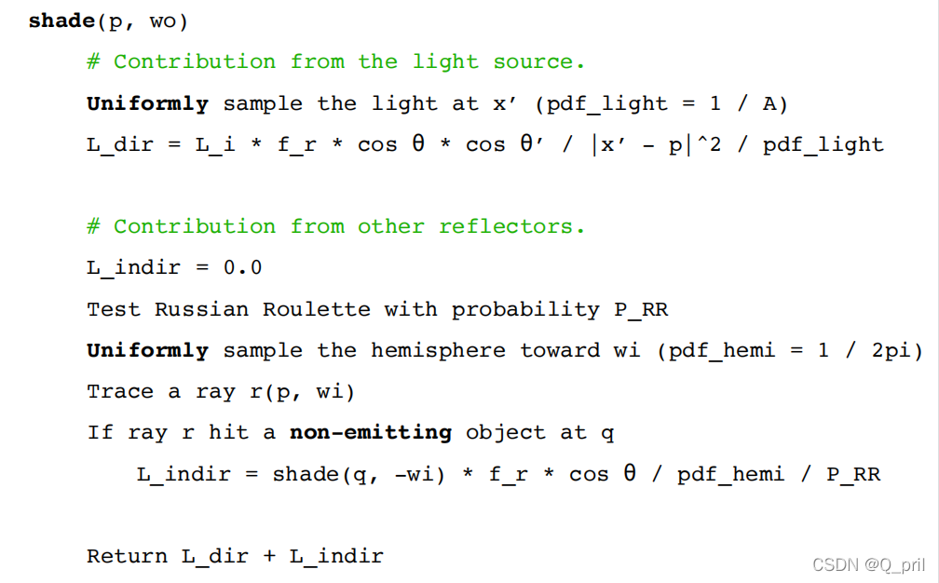
Implementation (Serial)

Slide 13
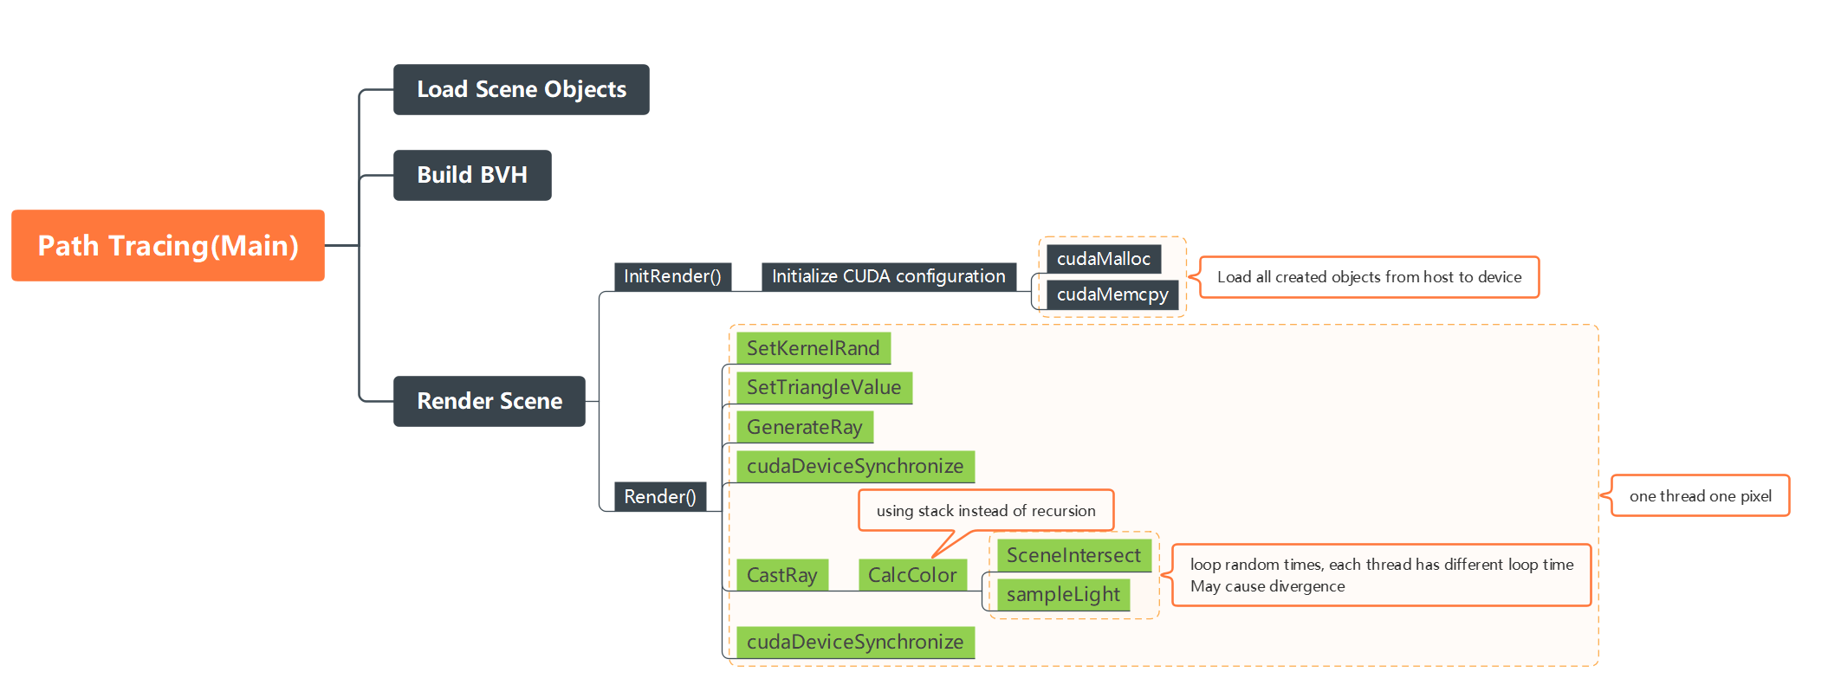
Implementation (OpenMP)

Slide 14
Implementation (CUDA)

Slide 15
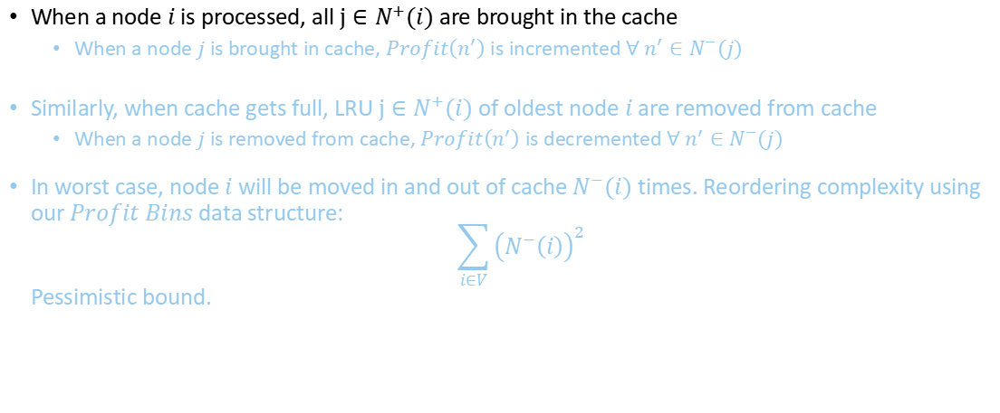
Implementation (what should I add??)
When a node $i$ is processed, all $j∈N^{+}(i)$ are brought in the cache
When a node $j$ is brought in cache, $Profit\left(n^{′}\right)$is incremented $∀ n^{′}∈N^{−}(j)$
Similarly, when cache gets full, LRU $j∈N^{+}(i)$ of oldest node $i$ are removed from cache
When a node $j$ is removed from cache, $Profit\left(n^{′}\right)$is decremented $∀ n^{′}∈N^{−}(j)$
In worst case, node $i$ will be moved in and out of cache $N^{−}(i)$ times. Reordering complexity using our $Profit Bins$ data structure: $\sum_{i∈V}{{\left(N^{−}\left(i\right)\right)}^{2}}$ Pessimistic bound.

Slide 16
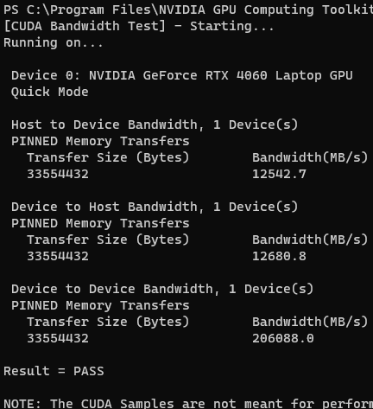
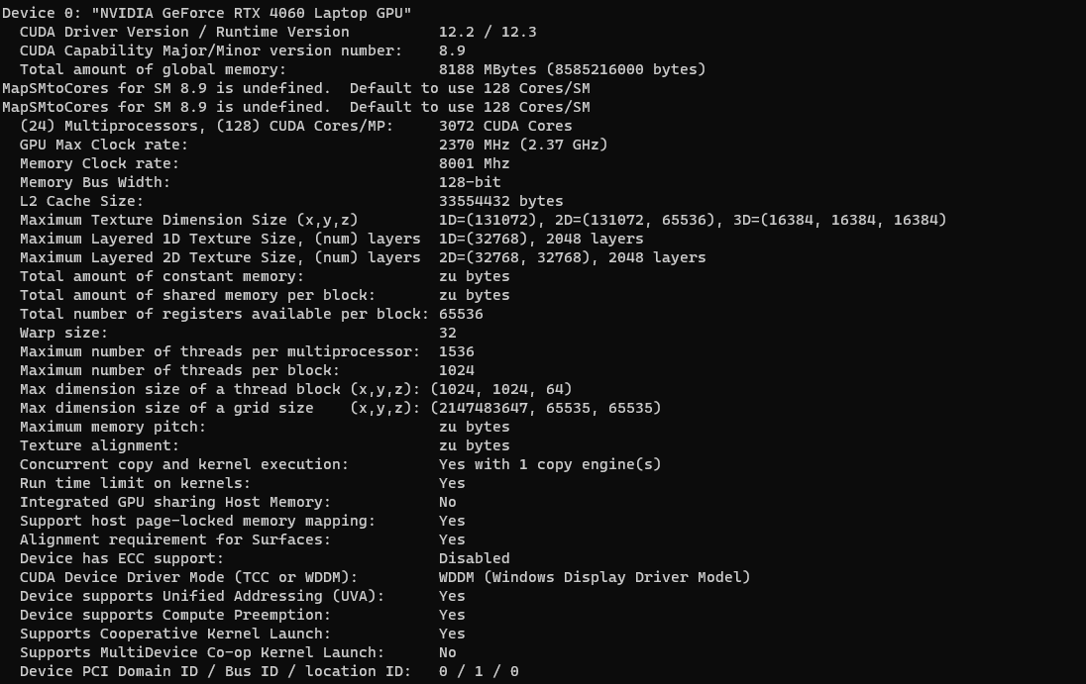
Experimental Setup

Slide 17
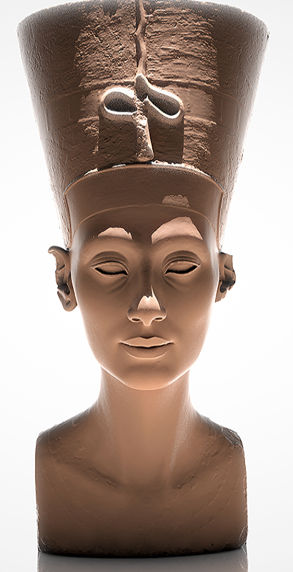
Experimental Setup
(Model object) Nefetiti (about 2M triangles, file size: 71.8MB)
(Setting) Server with AMD Opteron 6278 CPU (CARC check~!!)
2 sockets, 8 cores per socket. 128 GB DDR (graphs fit in memory)
L1 and L2 cache per core is 76 KB & 2 MB resp. shared L3 cache is 6 MB
Measure single threaded performance and multi threaded performance (using openMP and CUDA)
No. of threads: 1, 2, 4, 8, 16, 32, 64
Path tracing sample space: 1, 10, 100, 1000 …

Slide 18
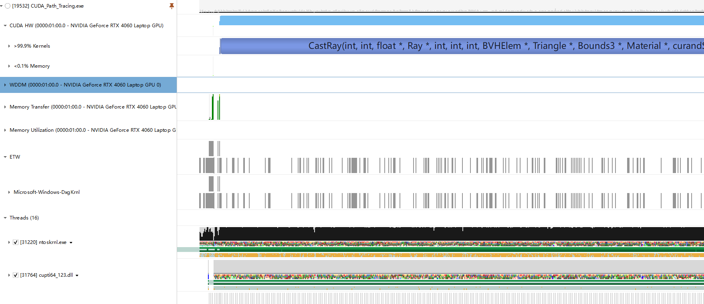
Performance analysis:
Read
Memcpy
Render

Slide 19
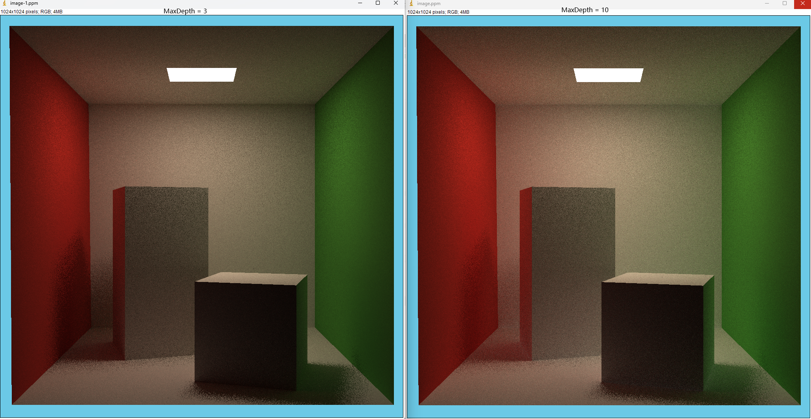
Performance analysis:
Changing MaxDepth will increase calculation time, but have little effect on the result.

Slide 20
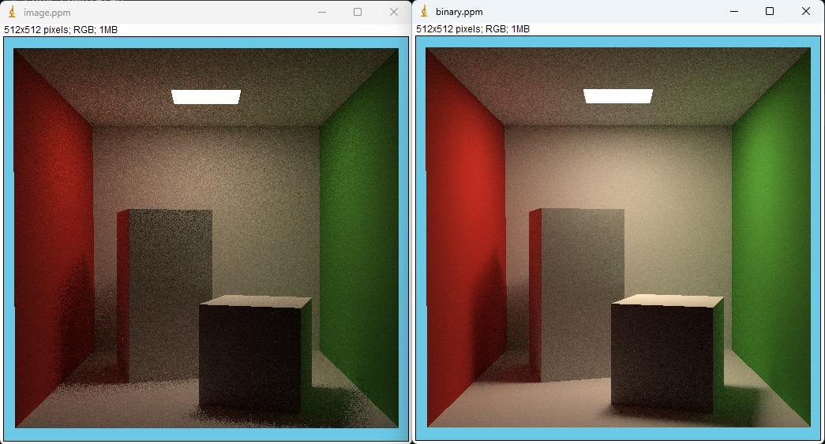
Performance analysis:
8 sec
93 sec
Implementation on CUDA is slightly different to achieve maximized speedup. (next step is to a

Slide 21
Performance analysis:
Need more testing data to make a form!!!!!!

Slide 22
Conclusion
Irregular memory accesses and lack of data locality makes graph processing challenging. We observed that for large datasets, cache efficiency is very poor (30-35% cache miss rate for pld, sd1).

Slide 23
References
Yunming Zhang, Vladimir Kiriansky, Charith Mendis, Matei Zaharia, and Saman P. Amarasinghe. Optimizing cache performance for graph analytics. CoRR, abs/1608.01362, 2016
[1] Rost, Randi J ; Licea-Kane, Bill ; Ginsburg, Dan ; Kessenich, John ; Lichtenbelt, Barthold ; Malan, Hugh ; Weiblen, Mike, “OpenGL shading language”, Pearson Addision Wiseley; 2021
[2] Gordon, V.scott, “Computer Graphics Programming in OpenGL with C++”, Bloomfield, New jersey : Mercury Learning & Information; 2020
[1] OpenGL, https://www.opengl.org, accessed 2023-10-20
[2] KHORONOS group, https://www.khronos.org/opengl, accessed 2023-10-20
PATH TRACING: A NON-BIASED SOLUTION TO THE RENDERING EQUATION ROBERT CARR AND BYRON HULCHER
Real-Time Bidirectional Path Tracing via Rasterization Yusuke Tokuyoshi∗ Square Enix Co., Ltd. Shinji Ogaki† Square Enix Co., Ltd.
Ray Tracing References • “An Improved Illumination Model for Shaded Display”, Turner Whitted, 1980 • “Distributed Ray Tracing”, Cook, Porter, Carpenter, 1984 • “The Rendering Equation”, James Kajiya, 1986 • “Bidirectional Path Tracing”, Eric Lafortune, Yves Willems, 1993 • “Rendering Caustics on Non-Lambertian Surfaces”, Henrik Wann Jensen, 1996 • “Metropolis Light Transport”, Eric Veach, Leonidas Guibas, 1997
A Reflectance Graphics ROBERT L. COOK Lucasfilm Ltd. and KENNETH E. TORRANCE Cornell University
Real-Time Rendering Fourth Edition
Online chapter: Real-Time Ray Tracing version 1.4; November 5, 2018
Download latest from http://realtimerendering.com
Tomas Akenine-M ̈oller Eric Haines Naty Hoffman Angelo Pesce
Michal Iwanicki S ́ebastien Hillaire

